Slide 1
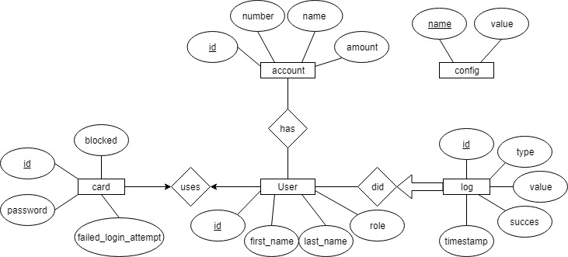
account (id : int, number : varchar, name : varchar, amount : Decimal)
user (id : int, first_name : varchar, last_name : varchar, role : tinyint)
card (id : int, password : varchar, failed_login_attempt : tinyint, blocked : tinynt)
Log (id : int, type : varchar, value : varchar, succes : tinyint, timestamp : datetime)
Config (name : varchar, value : varchar)
has (account.id [FK→account] : int, user.id [FK→user])
uses (user.id [FK→user] : int, card.id [FK→card] : int)
did (log.id [FK→log])

Slide 3
CREATE SCHEMA IF NOT EXISTS `mybank` DEFAULT CHARACTER SET utf8 ;USE `mybank` ;
-------------------------------------------- Table `mybank`.`account`-- -------------------------------------------------
CREATE TABLE IF NOT EXISTS `mybank`.`account` (
`id` INT(10) UNSIGNED NOT NULL AUTO_INCREMENT,
`number` VARCHAR(34) NOT NULL,
`name` VARCHAR(45) NOT NULL,
`amount` DECIMAL(19,2) NOT NULL DEFAULT '0.00',
PRIMARY KEY (`id`))ENGINE = Inno
DBAUTO_INCREMENT = 2
DEFAULT CHARACTER SET = utf8;
-- -------------------------------------------- Table `mybank`.`user`------------------------------------------------------
CREATE TABLE IF NOT EXISTS `mybank`.`user` (
`id` INT(10) UNSIGNED NOT NULL AUTO_INCREMENT,
`first_name` VARCHAR(45) NOT NULL,
`last_name` VARCHAR(45) NOT NULL,
`role` TINYINT(4) NOT NULL,
PRIMARY KEY (`id`))ENGINE = Inno
DBAUTO_INCREMENT = 4
DEFAULT CHARACTER SET = utf8;

Slide 4
------------------------------------------ Table `mybank`.`card`-- ----------------------------------------
CREATE TABLE IF NOT EXISTS `mybank`.`card` (
`id` VARCHAR(12) NOT NULL, `
user_id` INT(10) UNSIGNED NOT NULL,
`password` VARCHAR(64) NULL DEFAULT NULL,
`failed_login_attempt` TINYINT(3) UNSIGNED NOT NULL,
`blocked` TINYINT(3) UNSIGNED NOT NULL,
PRIMARY KEY (`id`),
INDEX `fk_card_user1_idx` (`user_id` ASC),
CONSTRAINT `fk_card_user1`
FOREIGN KEY (`user_id`)
REFERENCES `mybank`.`user` (`id`)
ON DELETE NO ACTION
ON UPDATE NO ACTION)
ENGINE = Inno
DBDEFAULT CHARACTER SET = utf8;

Slide 5
------------------------- Table `mybank`.`config`-- --------------------------------------------------
CREATE TABLE IF NOT EXISTS `mybank`.`config` (
`name` VARCHAR(45) NOT NULL,
`value` VARCHAR(255) NULL DEFAULT NULL,
PRIMARY KEY (`name`))
ENGINE = Inno
DBDEFAULT CHARACTER SET = utf8;

Slide 6
-- ------------------------------------------ Table `mybank`.`log`-- -----------------------------------------------------CREATE TABLE IF NOT EXISTS `mybank`.`log` (
`id` INT(10) UNSIGNED NOT NULL AUTO_INCREMENT,
`user_id` INT(10) UNSIGNED NOT NULL,
`type` VARCHAR(45) NULL DEFAULT NULL,
`value` VARCHAR(45) NULL DEFAULT NULL,
`success` TINYINT(4) NULL DEFAULT NULL,
`account_number` VARCHAR(34) NOT NULL,
`timestamp` DATETIME NOT NULL,
PRIMARY KEY (`id`),
INDEX `fk_Log_User1_idx` (`user_id` ASC),
CONSTRAINT `fk_Log_User1`
FOREIGN KEY (`user_id`)
REFERENCES `mybank`.`user` (`id`)
ON DELETE NO ACTION
ON UPDATE NO ACTION)
ENGINE = Inno
DBDEFAULT CHARACTER SET = utf8;

Slide 7
------------------------Table `mybank`.`user_has_account`-- ------------------------------------CREATE TABLE IF NOT EXISTS `mybank`.`user_has_account` (
`user_id` INT(10) UNSIGNED NOT NULL,
`account_id` INT(10) UNSIGNED NOT NULL,
PRIMARY KEY (`user_id`, `account_id`),
INDEX `fk_user_has_account_account1_idx` (`account_id` ASC),
INDEX `fk_user_has_account_user1_idx` (`user_id` ASC),
CONSTRAINT `fk_user_has_account_account1`
FOREIGN KEY (`account_id`)
REFERENCES `mybank`.`account` (`id`)
ON DELETE NO ACTION
ON UPDATE NO ACTION,
CONSTRAINT `fk_user_has_account_user1`
FOREIGN KEY (`user_id`)
REFERENCES `mybank`.`user` (`id`)
ON DELETE NO ACTION
ON UPDATE NO ACTION)
ENGINE = Inno
DBDEFAULT CHARACTER SET = utf8;
SET SQL_MODE=@OLD_SQL_MODE;
SET FOREIGN_KEY_CHECKS=@OLD_FOREIGN_KEY_CHECKS;
SET UNIQUE_CHECKS=@OLD_UNIQUE_CHECKS;

Slide 8
Normaliseren
Doordat er iemand met ervaring bij ons in de bytegroep zit, is er bij het ontwerpen van de database al rekening gehouden met normalisatie. Hierdoor staat de database al in normaalvorm 3.

